Slide 1
Twitter!
Rebecca Dickenson &
Kelly WIlliams
#TASLEast2017
Notes:
How did I get interested in twitter?
Joined Nov 2008; initially used it a lot like facebook, but slowly found other people to follow that were interesting (@joycevalenza, @neverendingsearch, @neilhimself). Then, HASHTAGS!
Principal pushed this year---@EESRavens, created @EESRavensLib

Slide 2
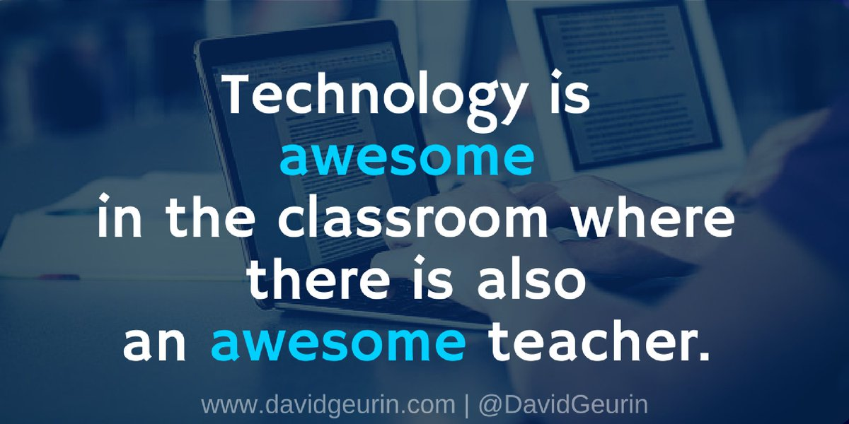

Slide 3
Why use twitter for PD?

Slide 4
Personalized
Connect with experts, authors!
Notes:
Librarians are often alone, can’t easily meet with grade levels.
PD that applies to YOU, and to YOUR interests,
Talking with other experts!

Slide 5
What’s your favorite Hashtag?
#edchat
#tlchat
#edtech
#libchat
#gafe4littles
#eessoars2016
Notes:
Tweet your favorite hashtags?

Slide 6
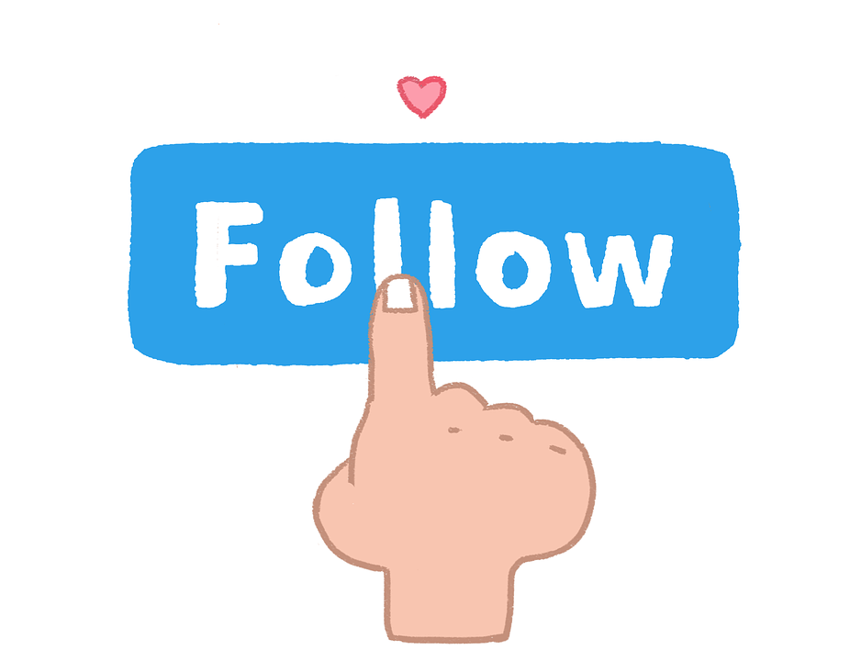
Who to follow?
@joycevalenza
@coolcatteacher
@The_Pigeon
@MrSchuReads
@TASLTN
Notes:
Tweet your favorite hashtags?

Slide 7
Why use Twitter to market your library?

Slide 8
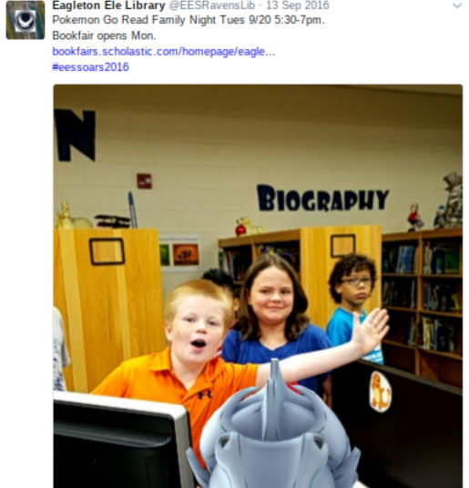
Examples
@EESRavensLib, --Just started this school year!
@Library_pes
@NYPL
@fwplibrary
Notes:
Tweet your favorite hashtags?

Slide 9
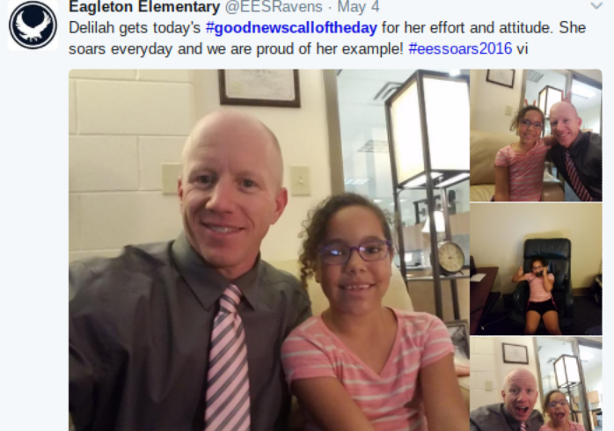
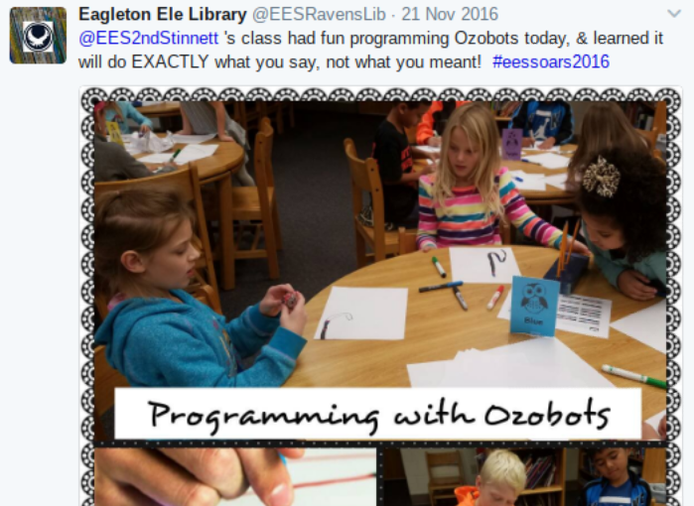
Share pictures of kids!

Slide 10
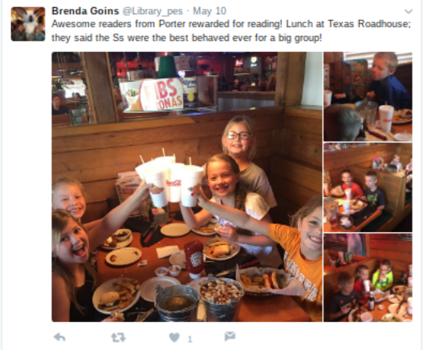
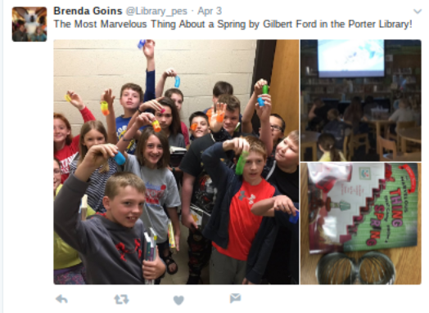

Slide 11
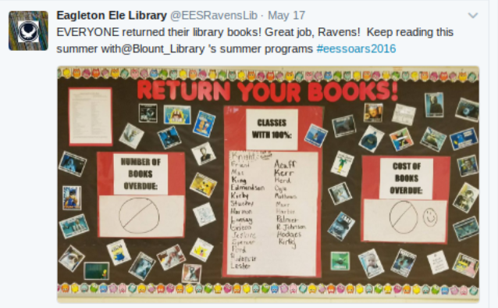
Update on school events

Slide 12
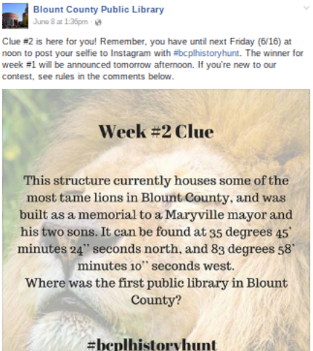
Contests?

Slide 13
Everything
Put your twitter handle on
Notes:
Don’t get discouraged if it takes a while to build up followers, get replies, etc.

Slide 14
Get started!

Slide 15
Sign up!
Choose a profile name. This is the name you'll be known as on Twitter (also know as your @name).
Add a photo of you
Complete your bio.
Add your website address.
Follow some people.
Get tweeting.
Don’t forget the hashtag!
Notes:
Tweet your favorite hashtags?

Slide 16
THANKS!
Any questions?
You can find me at @dickensonr, @EESRavensLib rebecca.dickenson@blountk12.org
865-256-1310
Find this presentation at: goo.gl/8ugdki
Presentation template by SlidesCarnival

